Slide 1















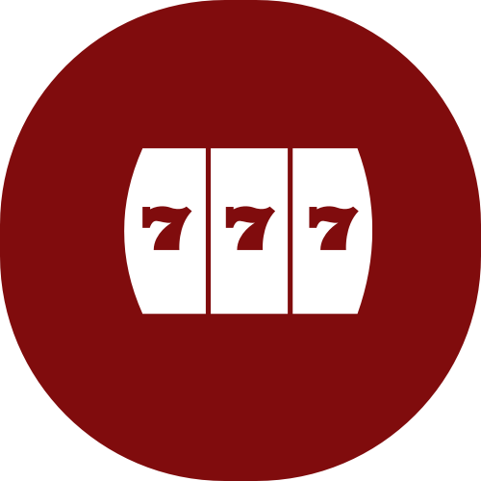











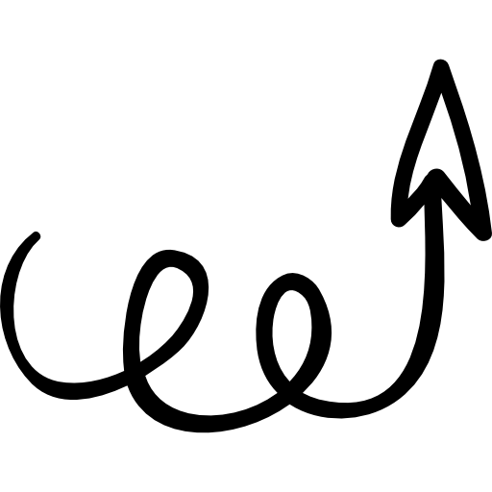



























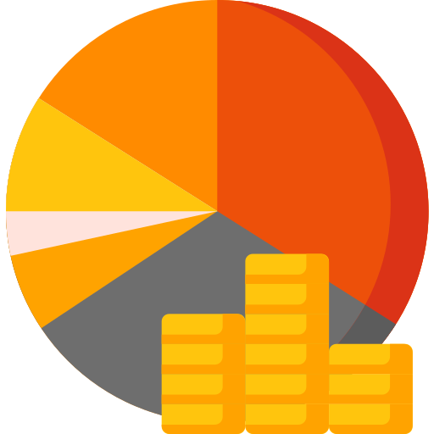


























































SCOPE
ACQUISITION CHANNELS
OTHER VISUALS

Slide 2


DOCUMENT
TITLE
DATE

Slide 3
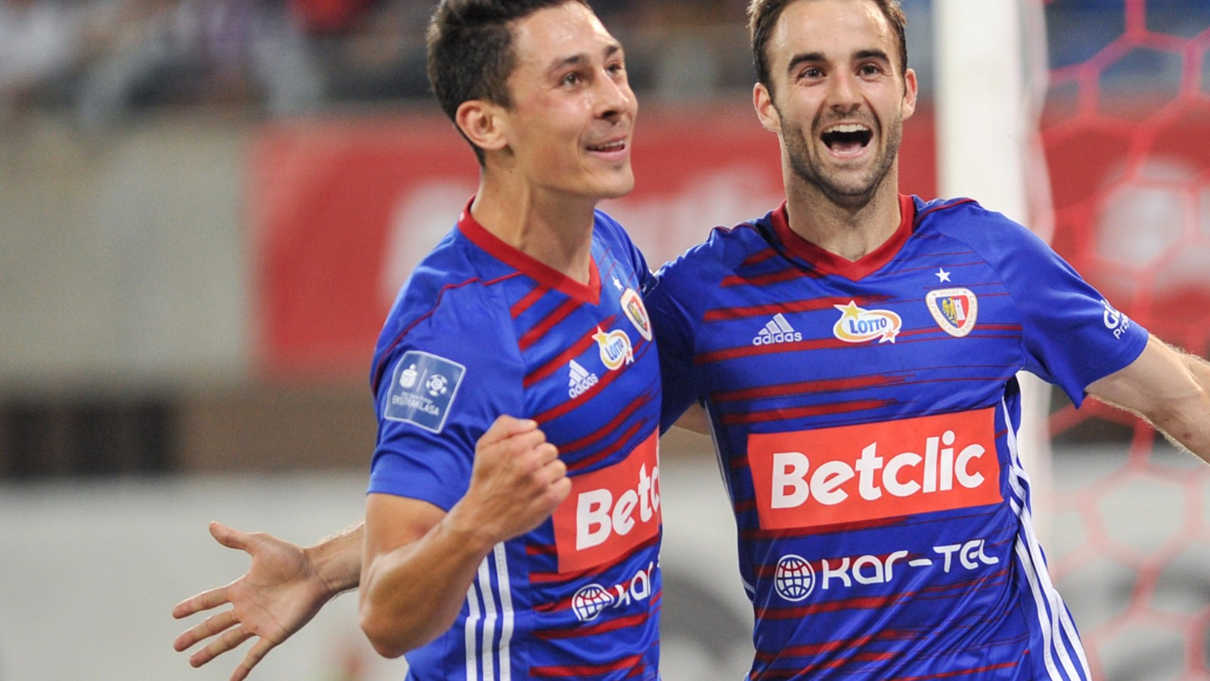

PART
ONE

Slide 4
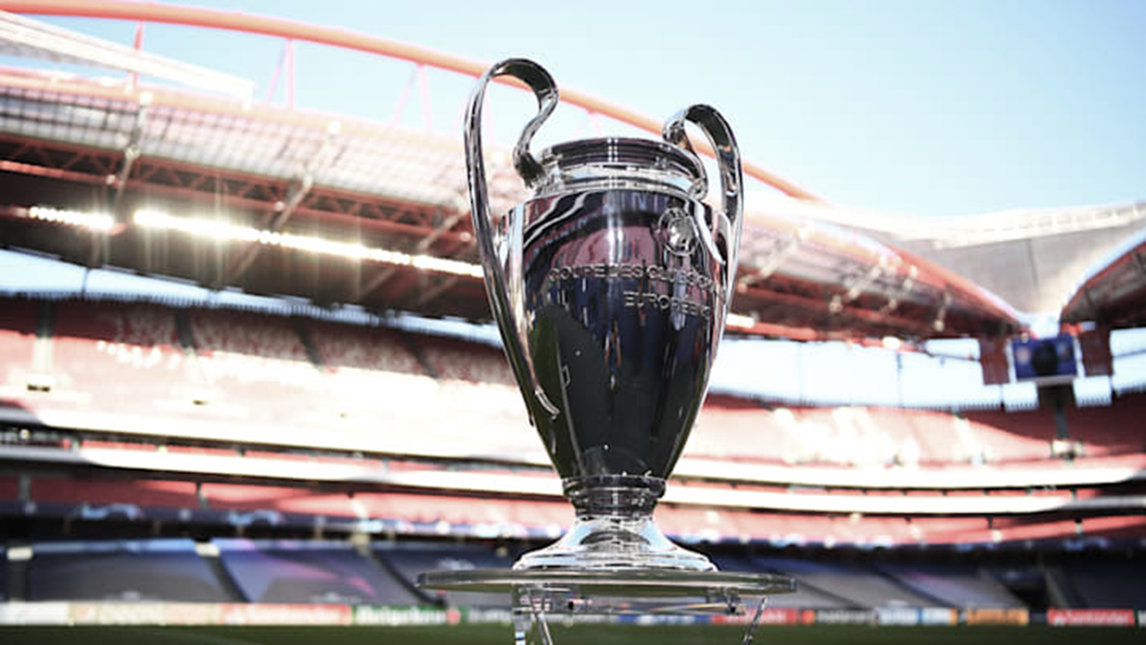
PART
ONE

Slide 5
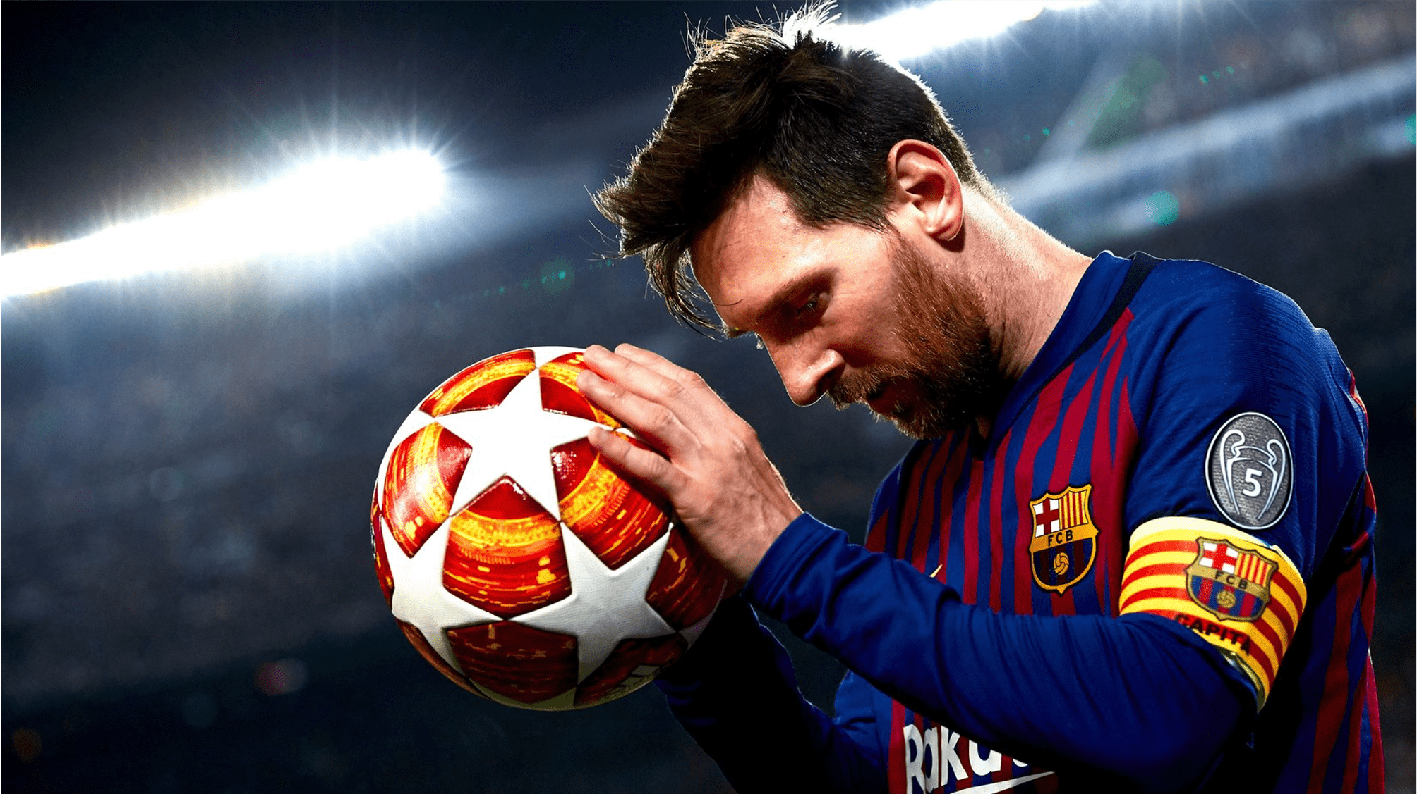
PART
ONE

Slide 6
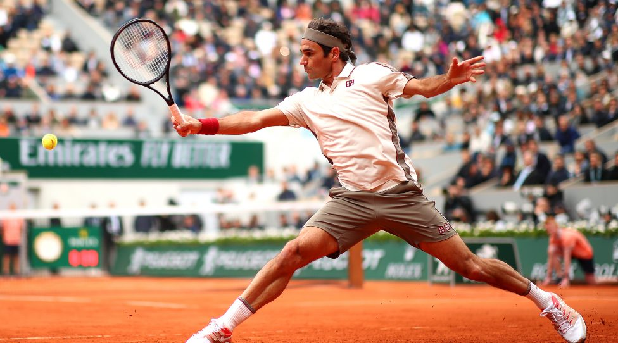
PART
TWO

Slide 7
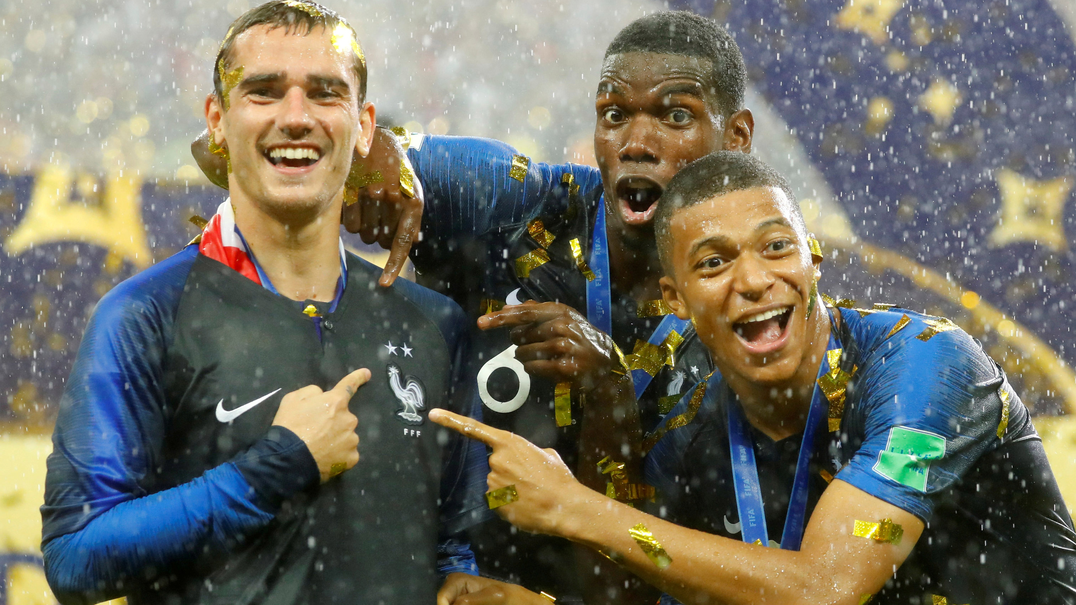
PART
THREE

Slide 8
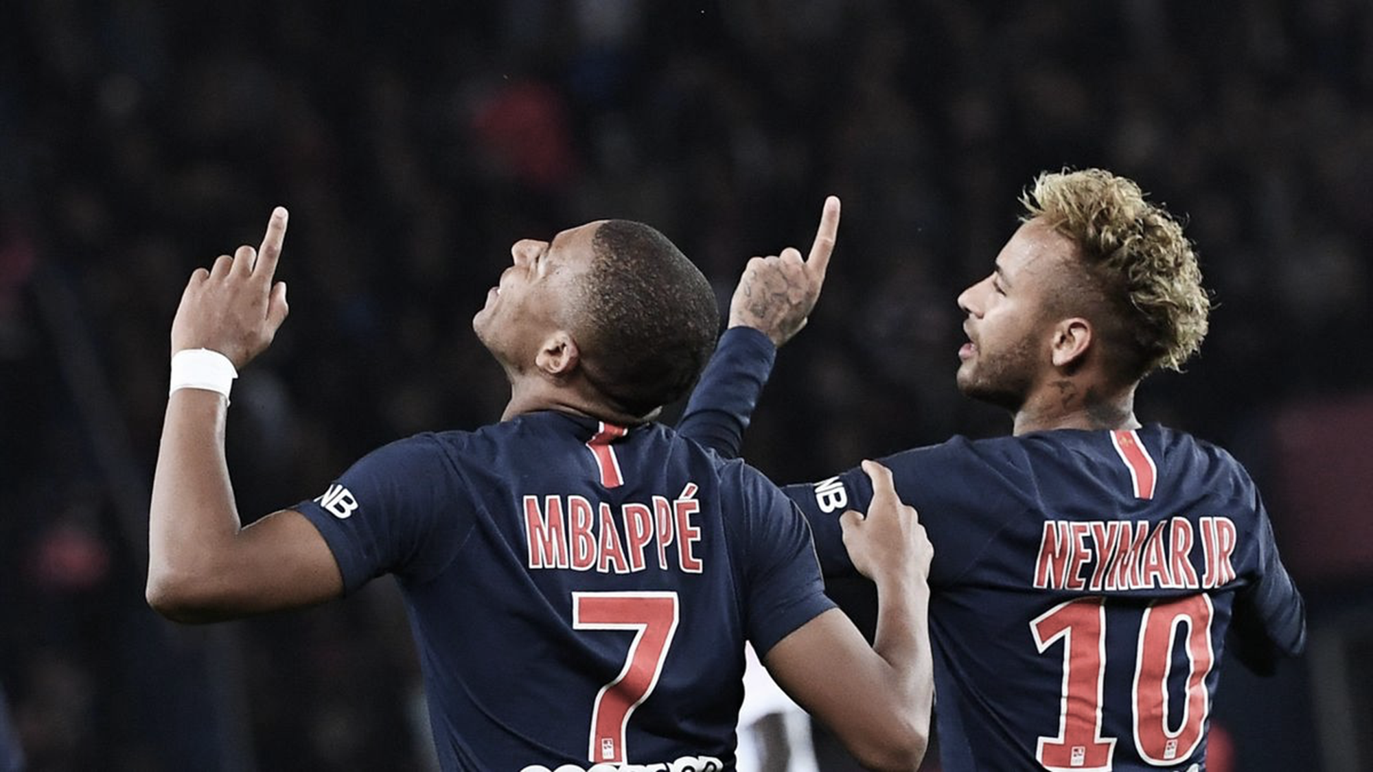
PART
ONE

Slide 9
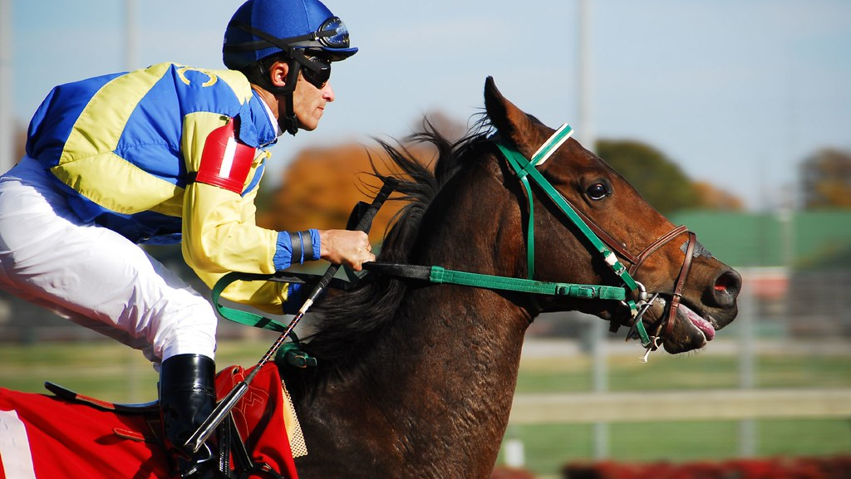
PART
THREE

Slide 10
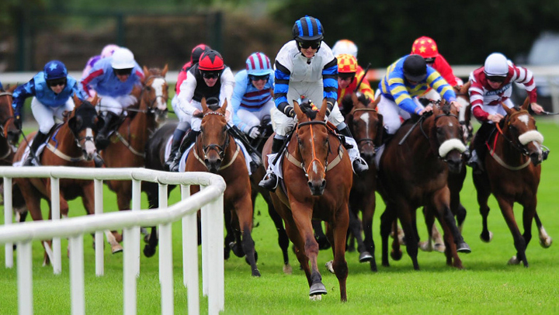
PART
THREE

Slide 11
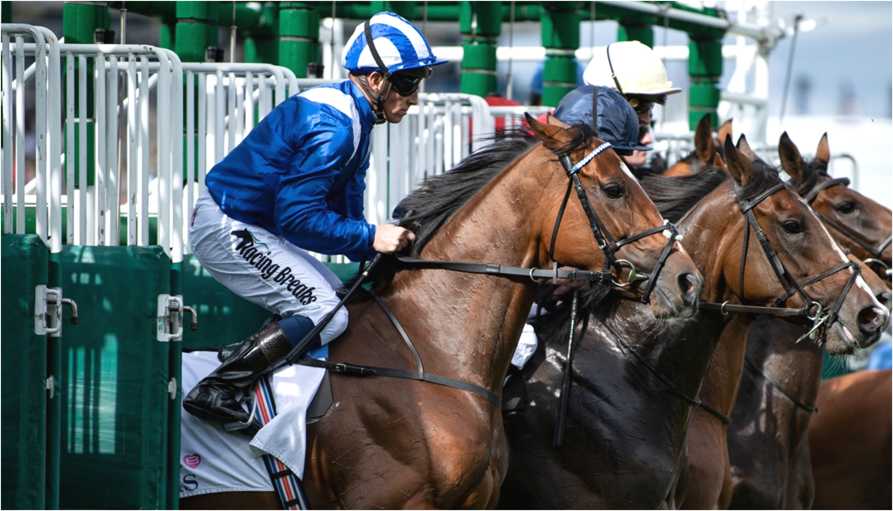
PART
THREE

Slide 12
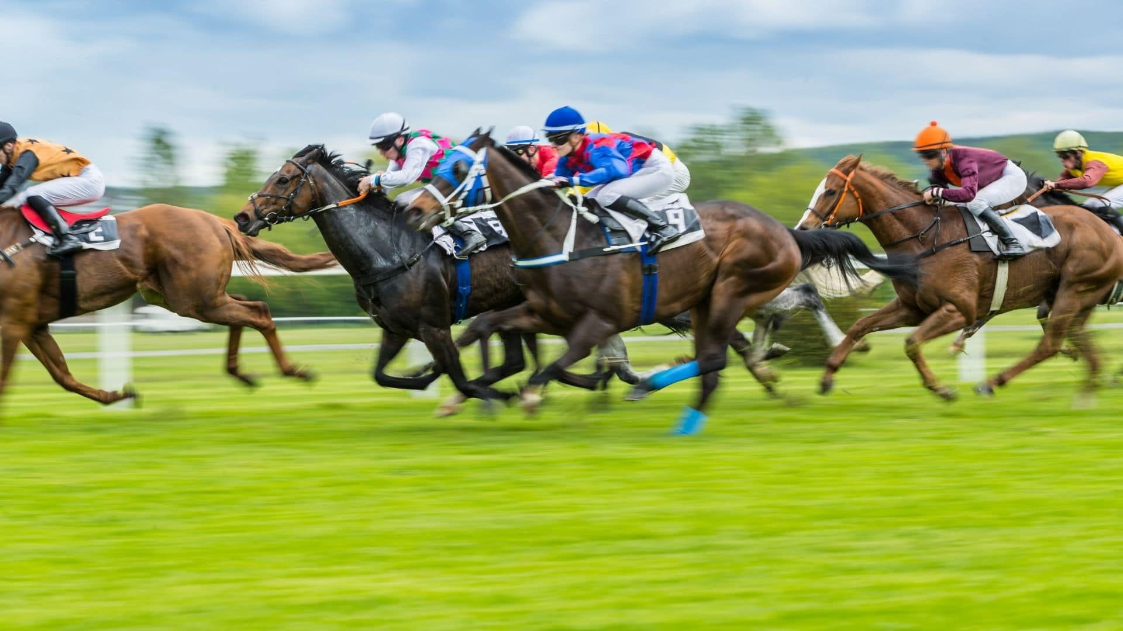
PART
THREE

Slide 13
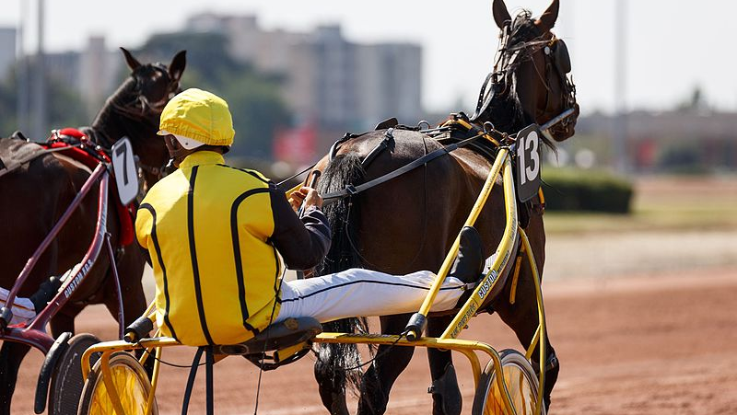
PART
THREE

Slide 14

PART
THREE
This Photo by Unknown Author is licensed under CC BY-SA-NC

Slide 15

PART
THREE

Slide 16
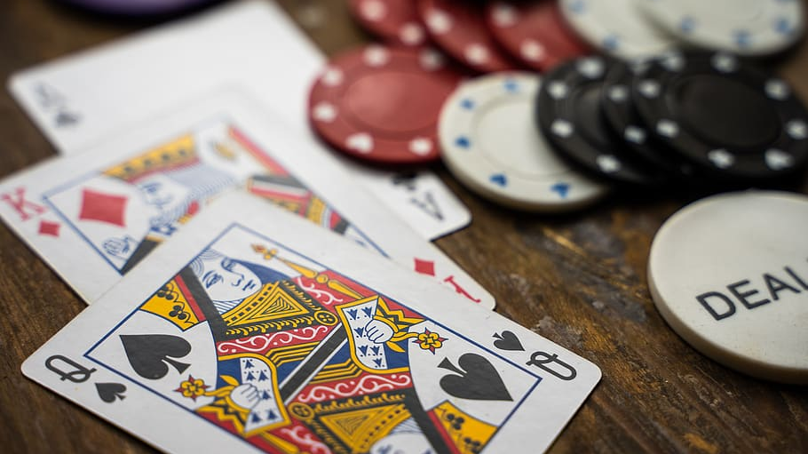
PART
THREE

Slide 17
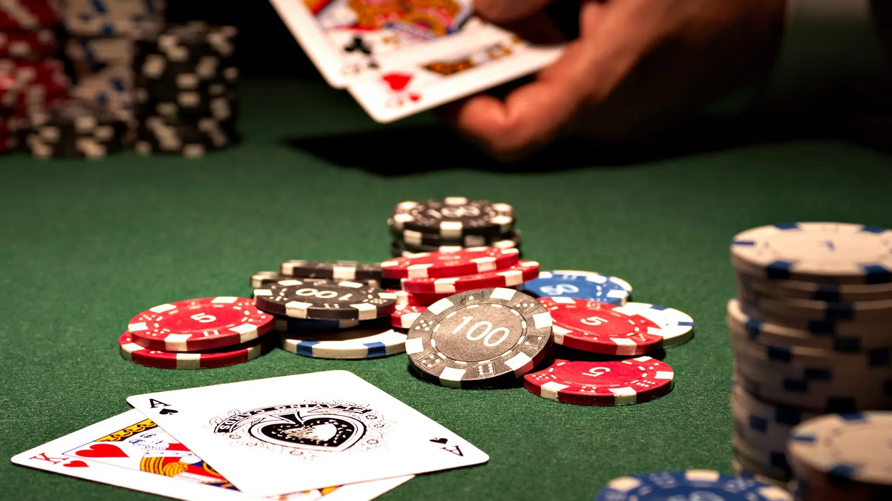
PART
THREE

Slide 18

PART
THREE

Slide 19
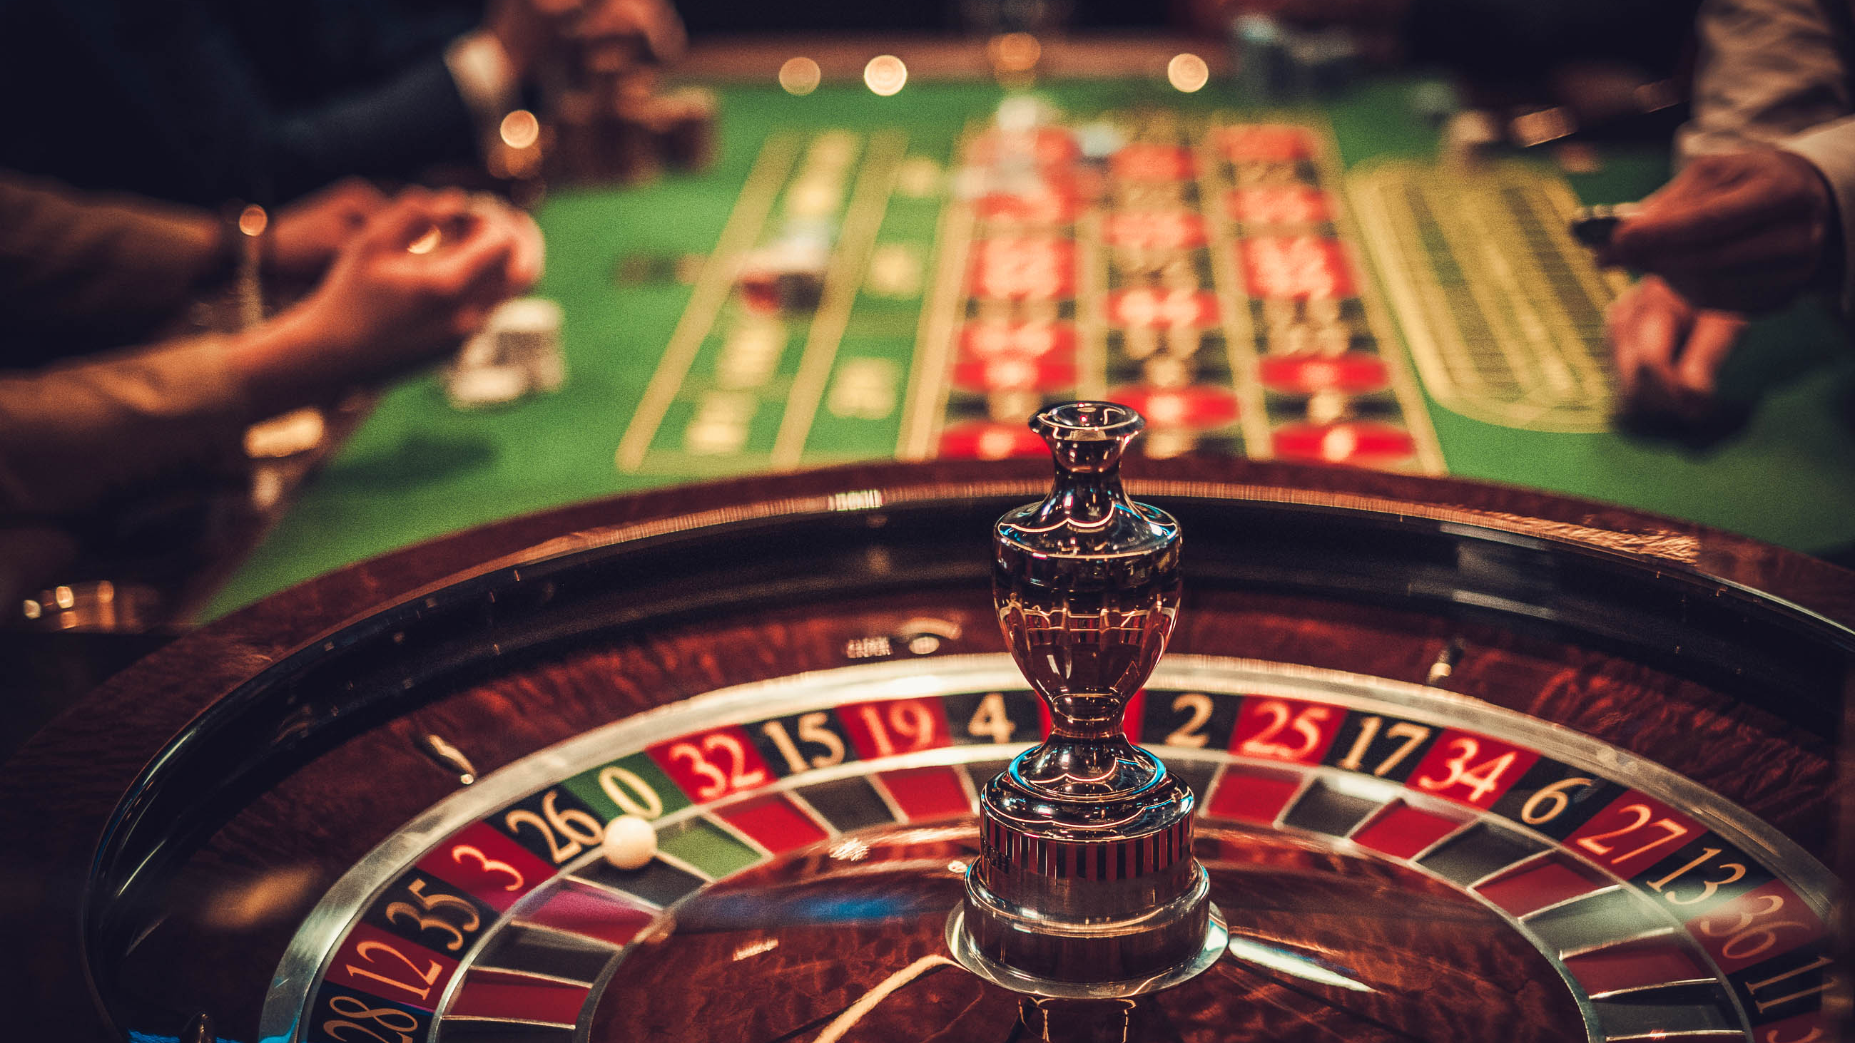
PART
THREE

Slide 20

PART
THREE

Slide 21
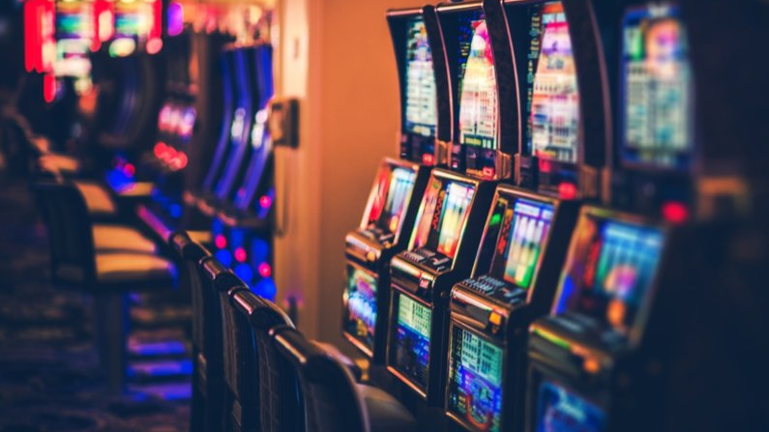
PART
THREE

Slide 22
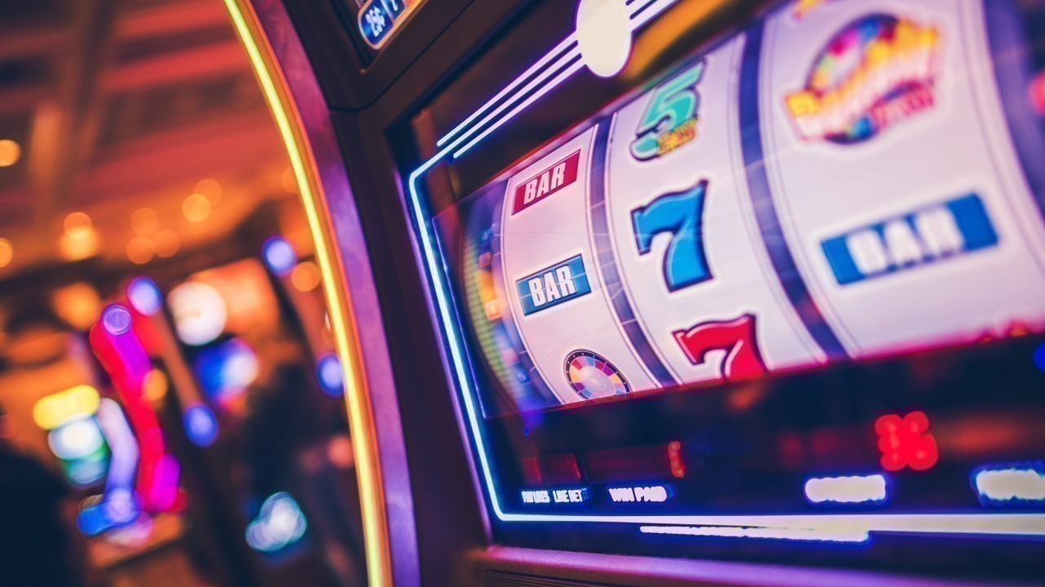
PART
THREE

Slide 23
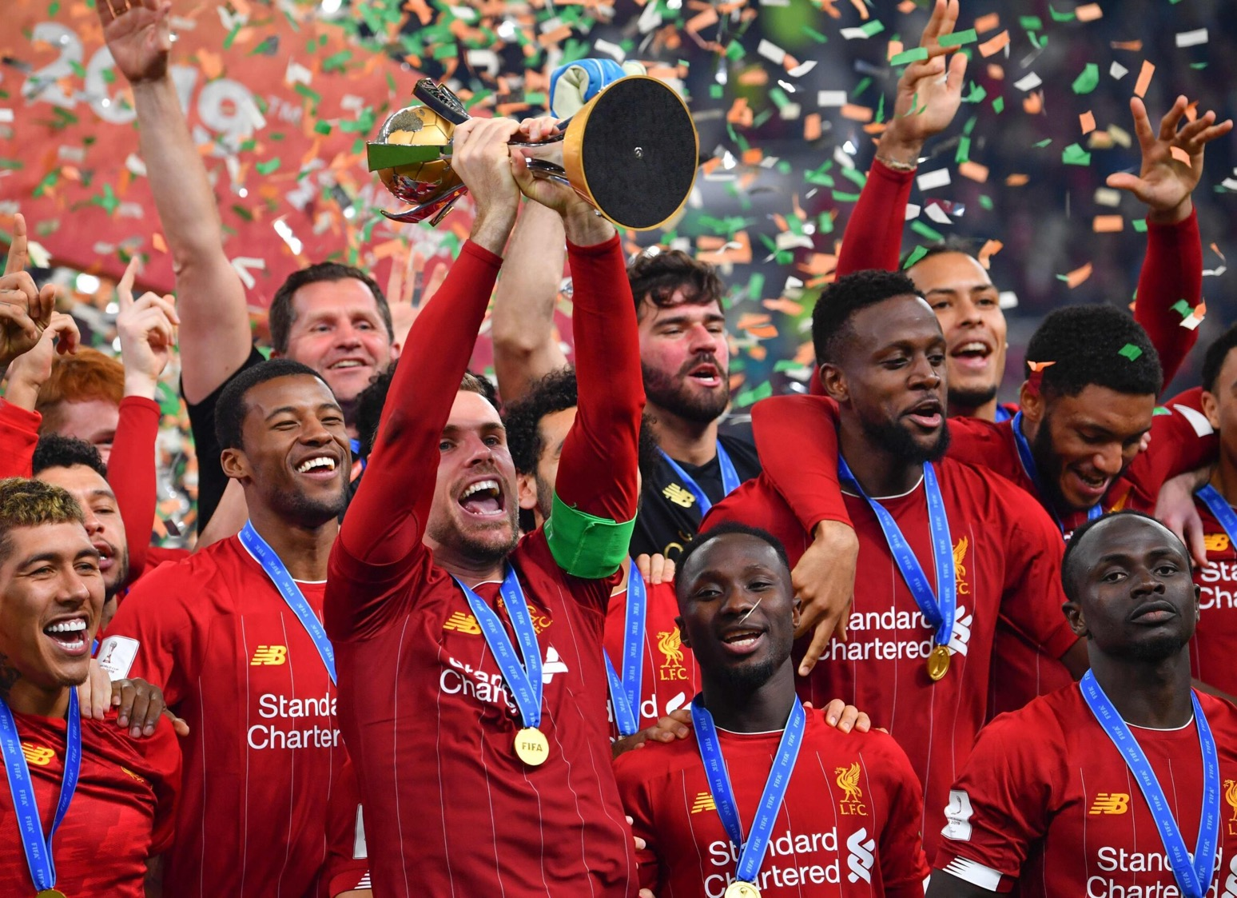
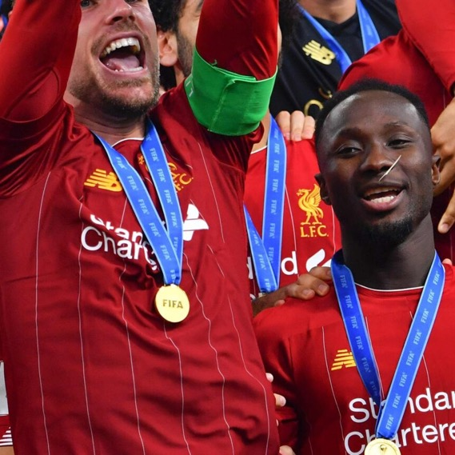
SUB-PART

Slide 24
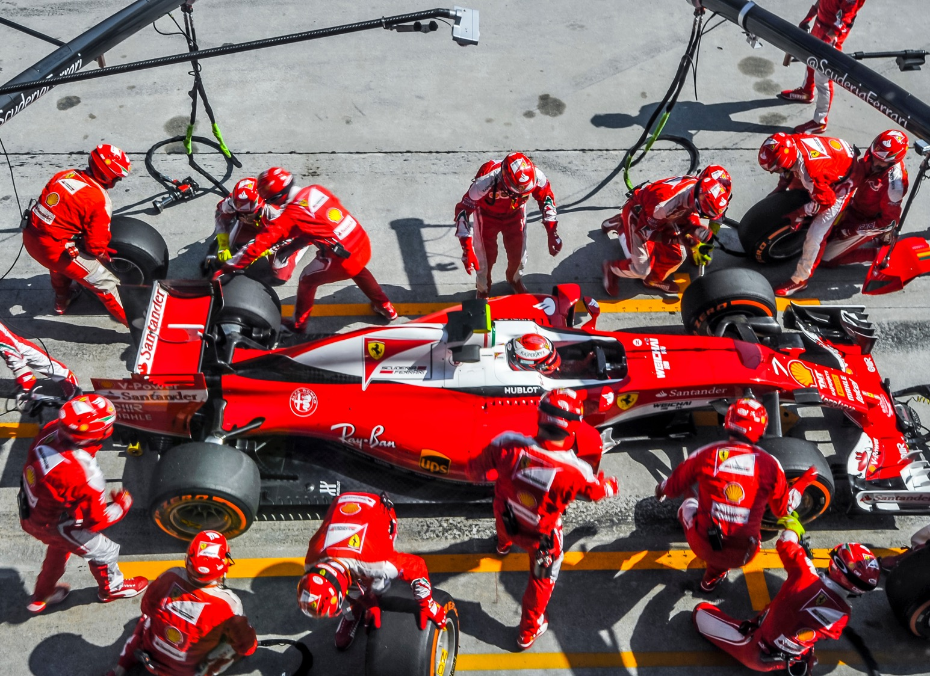
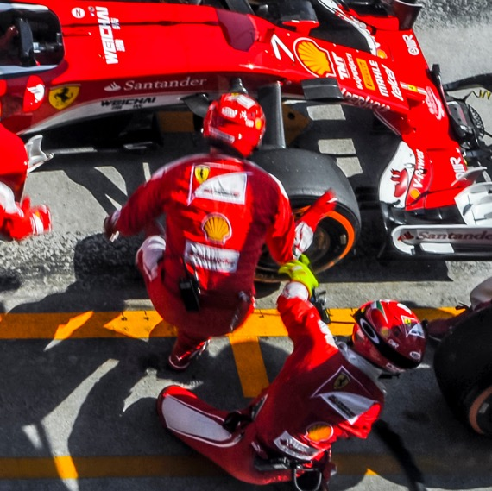
SUB-PART

Slide 25
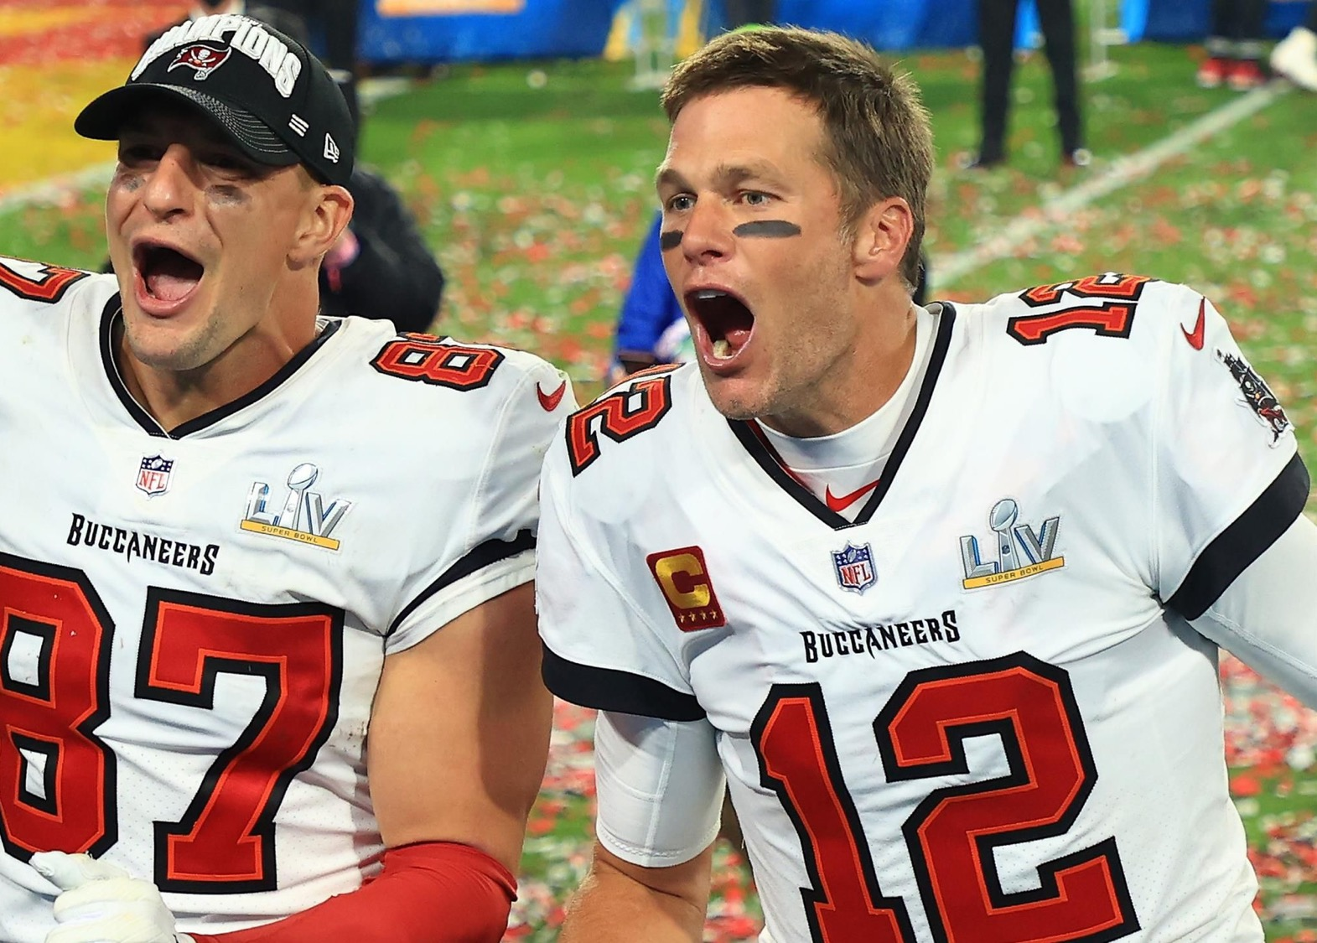
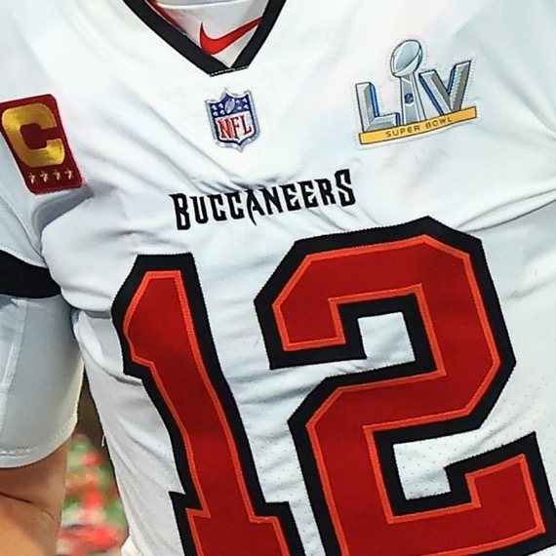
SUB-PART

Slide 26

SUB-PART

Slide 27
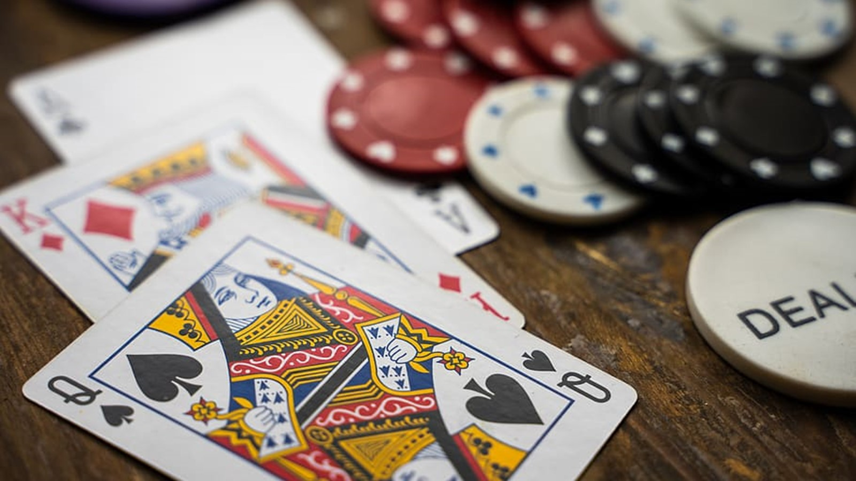
SUB-PART

Slide 28
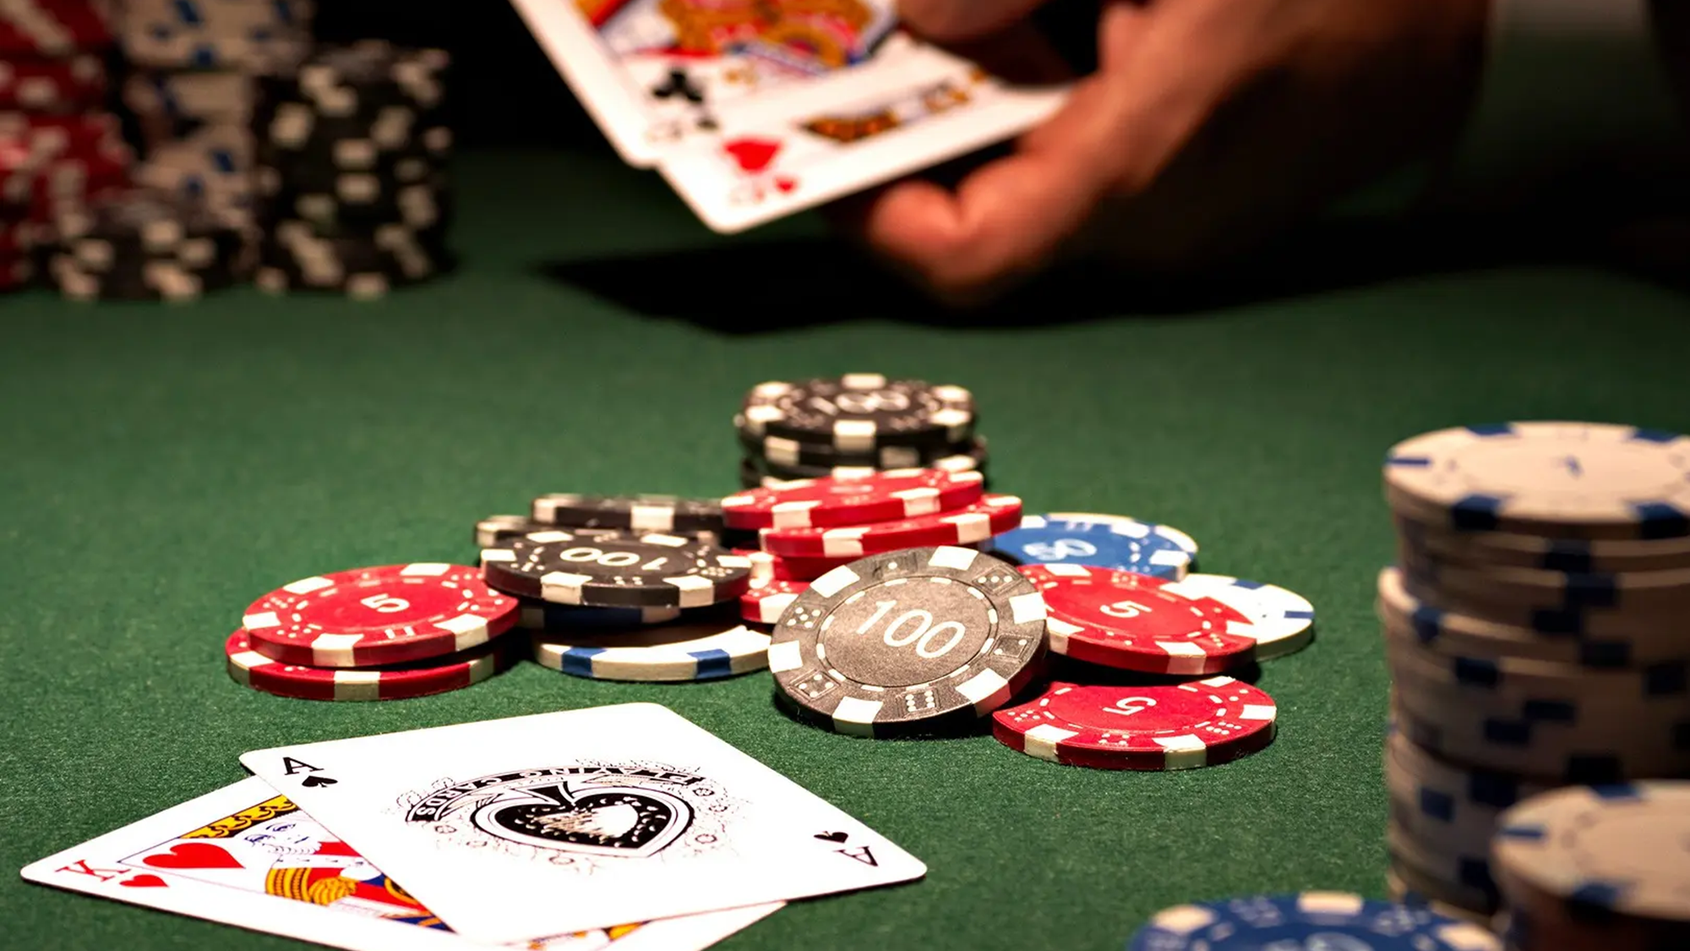
SUB-PART

Slide 29
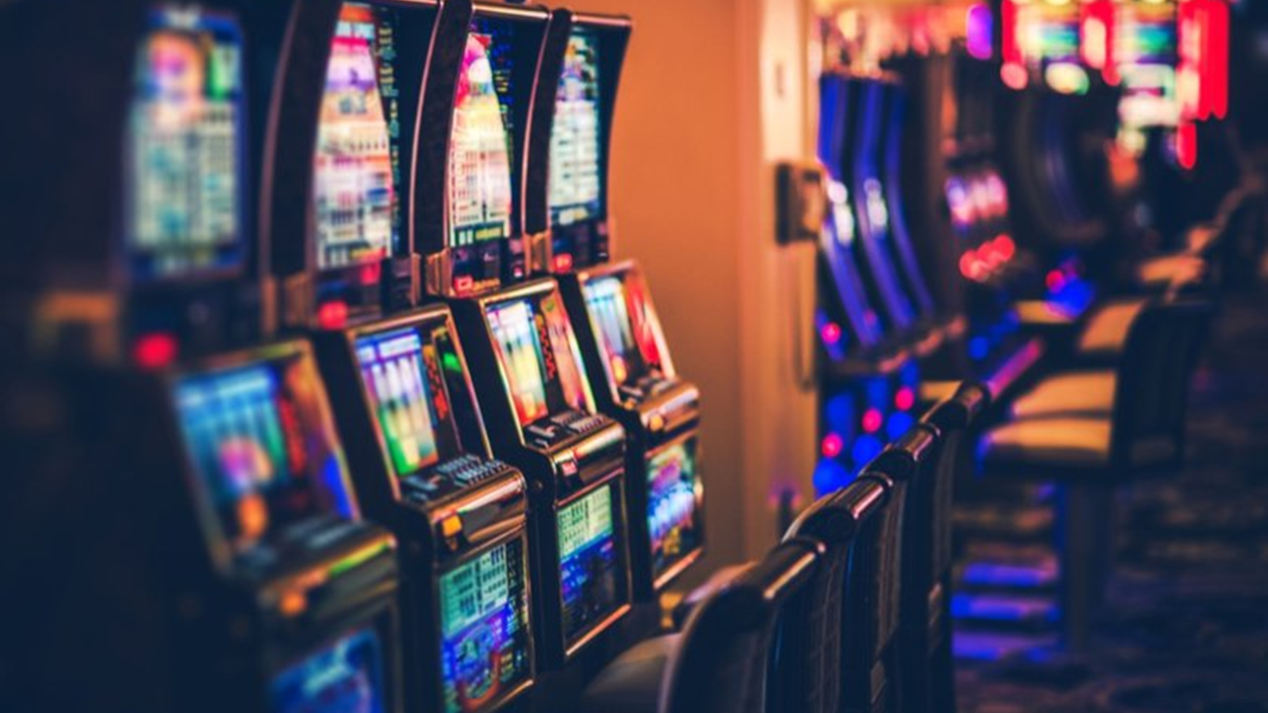
SUB-PART

Slide 30
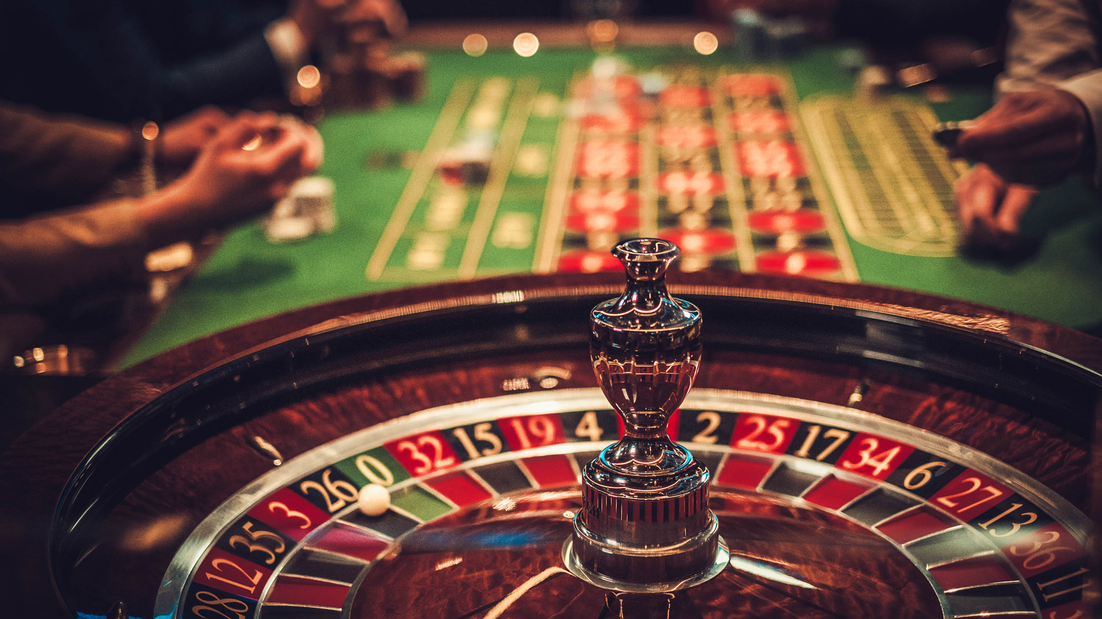
SUB-PART

Slide 31

SUB-PART

Slide 32
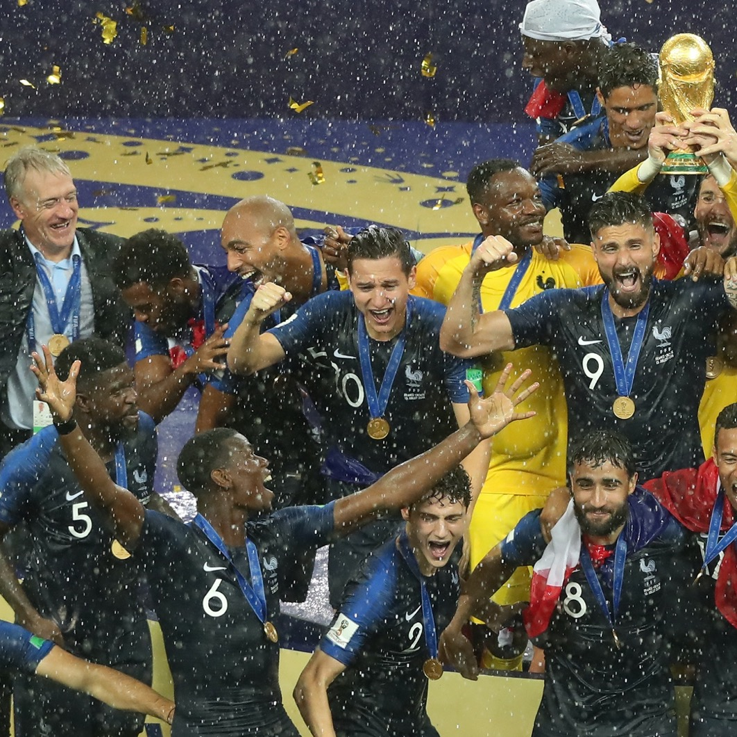


Texte
Notes:
Très réussie !

Slide 33
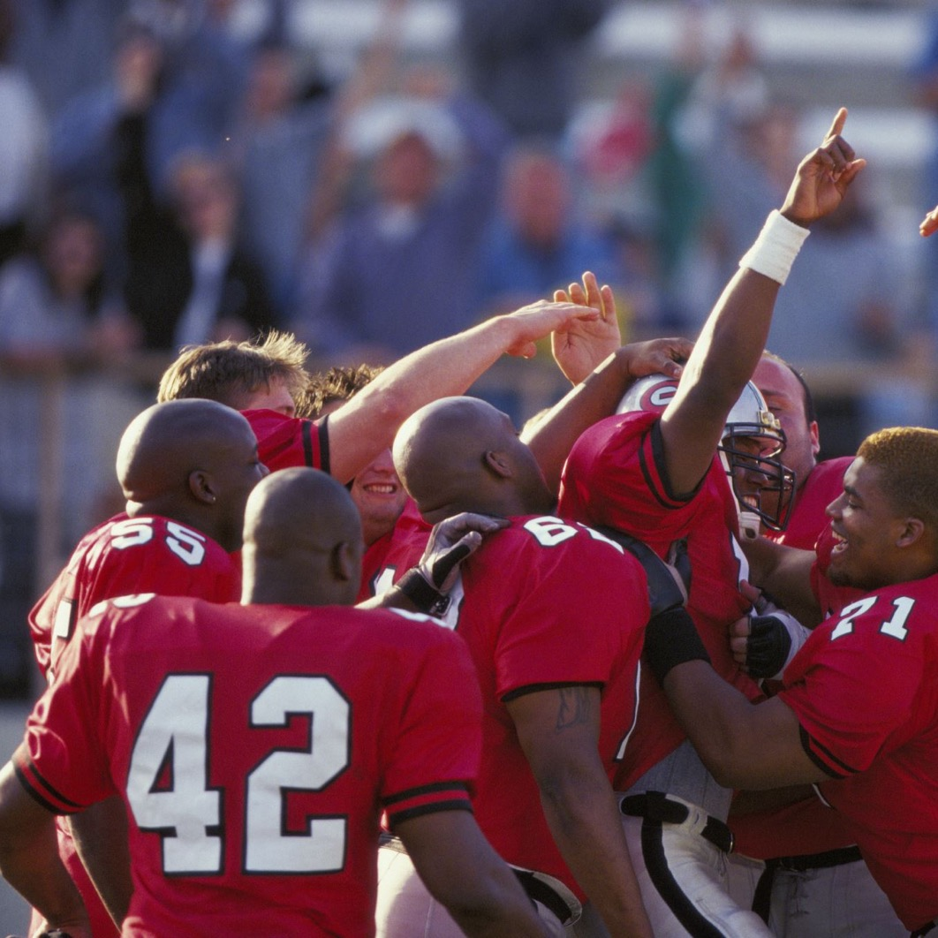

Notes:
Très réussie !

Slide 34


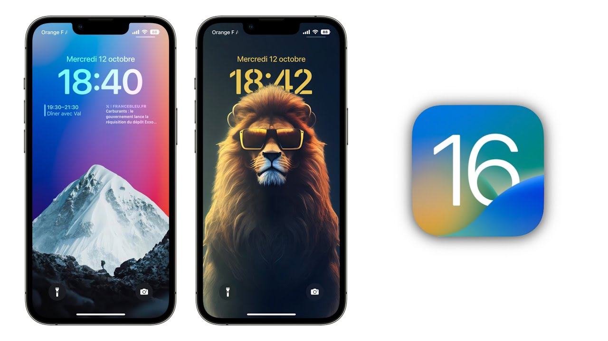
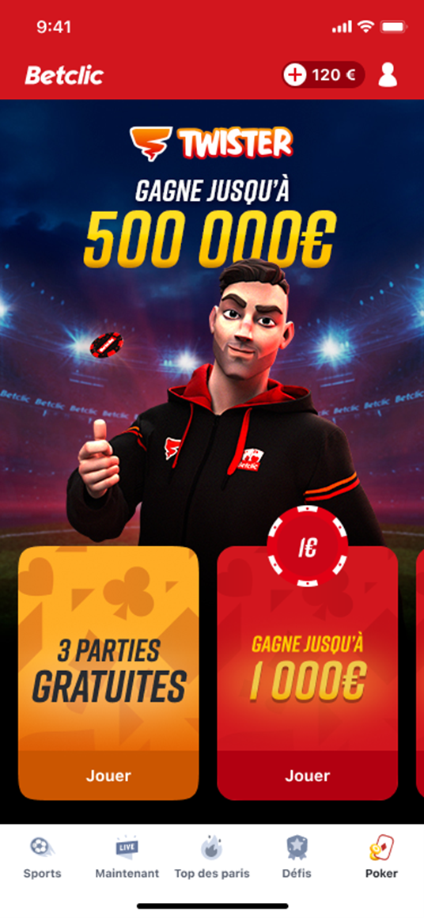
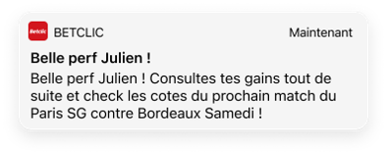
🤝 "SORRY, GOOD GAME" ♣
Quelle soirée ! 😍 Et si celle-ci se terminait dans la Bonus Zone ? 💥 Freebets, freetickets, cash ... Fais le plein de cadeaux après tous tes Twisters 5€ ! ✅
Notes:
Très réussie !

Slide 35

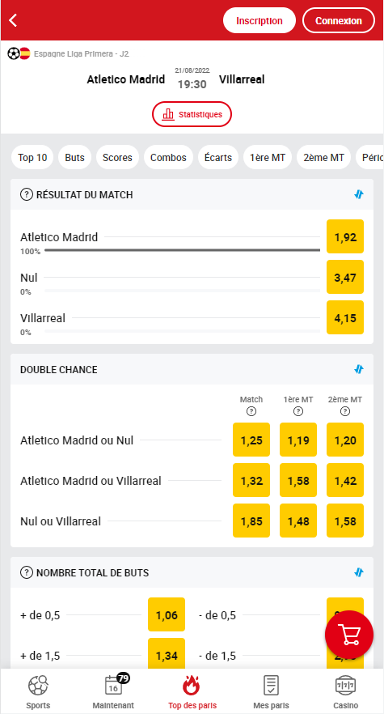
CONTEXT & ANALYSIS SCOPE
Period:
Universe(s):
Delivery date:
August 2022
Jira ticket:
DATATP-5965
Author(s):
Charlotte Lurton
Reviewer(s):
Sébastien HEZARD
From 2022-05-01
to 2022-06-30
App(s):
Platform(s):
Taking into consideration only sessions
where the user is logged in

Slide 36

CONTEXT & ANALYSIS SCOPE
Delivery date:
October 2022
Jira ticket:
DATATP-6120
Author(s):
Charlotte Lurton
Reviewer(s):
Florent de Boussiers
Period:
App(s):
From 2022-06-06
to 2022-10-23
Universe(s):
Platform(s):

Slide 37
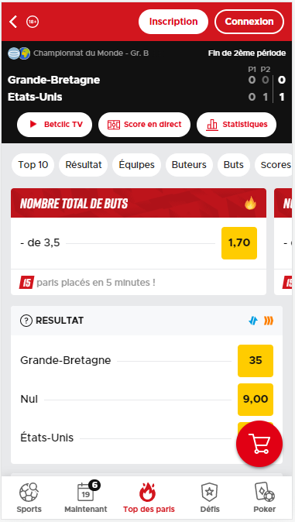
CONTEXT & ANALYSIS SCOPE
Period:
Delivery date:
May 2022
Jira ticket:
DATATP-5773
Author(s):
Charlotte Lurton
Reviewer(s):
Thomas Moreau
FEATURE WITH
UP TO 3 HOT BETS
From 2022-04-20
to 2022-05-03
FEATURE WITH
UP TO 5 HOT BETS
From 2022-05-05
to 2022-05-18
App(s):
Universe(s):
Platform(s):
Taking into consideration only accepted bets after the user has seen a live match page

Slide 38
CONTEXT & ANALYSIS SCOPE
Period:
Platform(s):
Delivery date:
March 2023
Jira tickets:
DATATP-6182
DATATP-6181
DATATP-6185
DATATP-6184
Authors:
Charlotte LURTON
Suzie BOUTARD
Reviewers:
Sara BELLOUTI
Nina MOSS
POKER
(Bonus Zone)
From 2022-11-17
to 2022-12-18
CASINO
(World Cup)
From 2022-11-20
to 2022-12-18
App(s):
Universe(s):
Push sent after PT and FR games to make sport players play Poker / Casino
(no offer)
“Aficionados”
Already X-sellers who bet during the day
Can be targeted several times
“Strangers”
Never been X-seller who bet on the day and with a positive win rate
Can be targeted only once

Slide 39


NOTES
188 172 Strangers targeted
KPI used to measure
the impact :
UAPS Poker / Casino
in the 48 hours following
the campaign
How to read?
66.2% of the Strangers that we converted in the 48h following the campaign played at least once between the date of the campaign and J+1
(it doesn’t mean that they haven’t played after)
3%
As an aficionado can be both
in a targeted group in a campaign and
in a control group in an other campaign,
the results are a bit biased.
4 859
players converted (in 48h)
Note: looking at the activity during the whole period of the Bonus Zone
23%
1 137
players
still playing
at J+30
In volume, as the number of UAPs increased during the Bonus Zone, TO/day and GGR/day increased too
But looking at the TO/day/UAP and the GGR/day/UAP, to better compare the 2 periods, we can see that players didn’t spend more during the Bonus Zone

Slide 40

Cest quoi l’active learning?
Diff ML et AL
Explication AL
Traing/Pool
4 stratégies
Explication des 3 data set
Une slide par conclusion :
Entre 10 et 60%
Retraining marche
Initialisation
Tableau recap strat
Conclu

Slide 41
Evalution Active Learning
Train
Pool
Test
Taille initiale : % de données labellisées au début (labeled_ratio)
A chaque itération : la taille augmente du % de données ajoutées (batch_ratio)
A chaque itération : la taille diminue du % de données ajoutées (batch_ratio)
Même ensemble de Test pour toutes les itérations
Paramètres à fixer :
labeled_ratio / Nb d’itération / Batch_ratio

Slide 42
Evalution Active Learning
Itération 1
Train
Pool
Test
Itération 2
Train
Pool
Test
Train
Pool
Test
On labellise les données les plus incertaines à chaque itération
Train
Pool
Test
Train
Pool
Test
Train
Pool
Test
Comment sélectionne-t-on les données les plus incertaines ?

Slide 43
Méthodes de sélection
- Random
- Least_confident
- Margin
-
- Entropy

Slide 44
Random
Chien
Chat
Renard
1
0.1 | 0.85 | 0.05
0.6 | 0.3 | 0.1
0.39 | 0.61 | 0.0
Proba
2
3
Random :
Sélection au hasard parmi les 3 sans considérer les probas

Slide 45
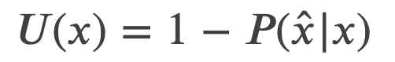
Least_confident
Least_confident :
Sélection du cas le moins confiant suivant la formule
avec x̂ la classe la plus probable
Chien
Chat
Renard
Uncertainty
1
0.1 | 0.85 | 0.05
0.6 | 0.3 | 0.1
0.39 | 0.61 | 0.0
1
0.15
0.4
0.39
Proba
2
2
3
3
Sélection du cas 2

Slide 46
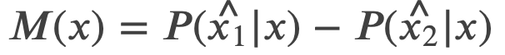
Margin
Margin :
Sélection du cas avec la plus faible marge entre les 2 classes les plus probables
avec x̂₁ et x̂₂ chapeau les 2 classes les plus probables
Chien
Chat
Renard
Margin
1
0.1 | 0.85 | 0.05
0.6 | 0.3 | 0.1
0.39 | 0.61 | 0.0
1
0.75
0.3
0.22
Proba
2
2
3
3
Sélection du cas 3

Slide 47
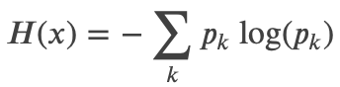
Entropy
Entropy :
Sélection du cas avec la haute entropie selon la formule
Chien
Chat
Renard
Entropy
1
0.1 | 0.85 | 0.05
0.6 | 0.3 | 0.1
0.39 | 0.61 | 0.0
1
0.52
0.89
0.67
Proba
2
2
3
3
Sélection du cas 2

Slide 48


THANKS!

Slide 49
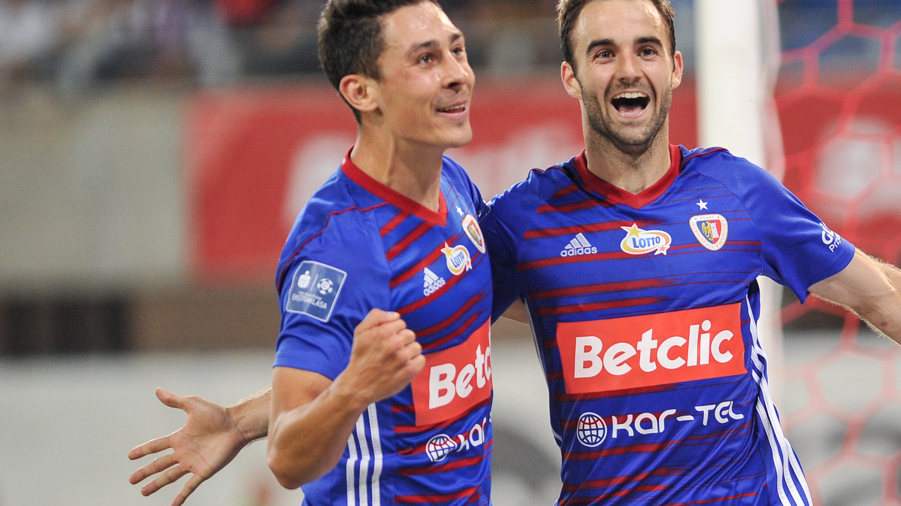
THANKS!

Slide 50
THANKS!

Slide 51
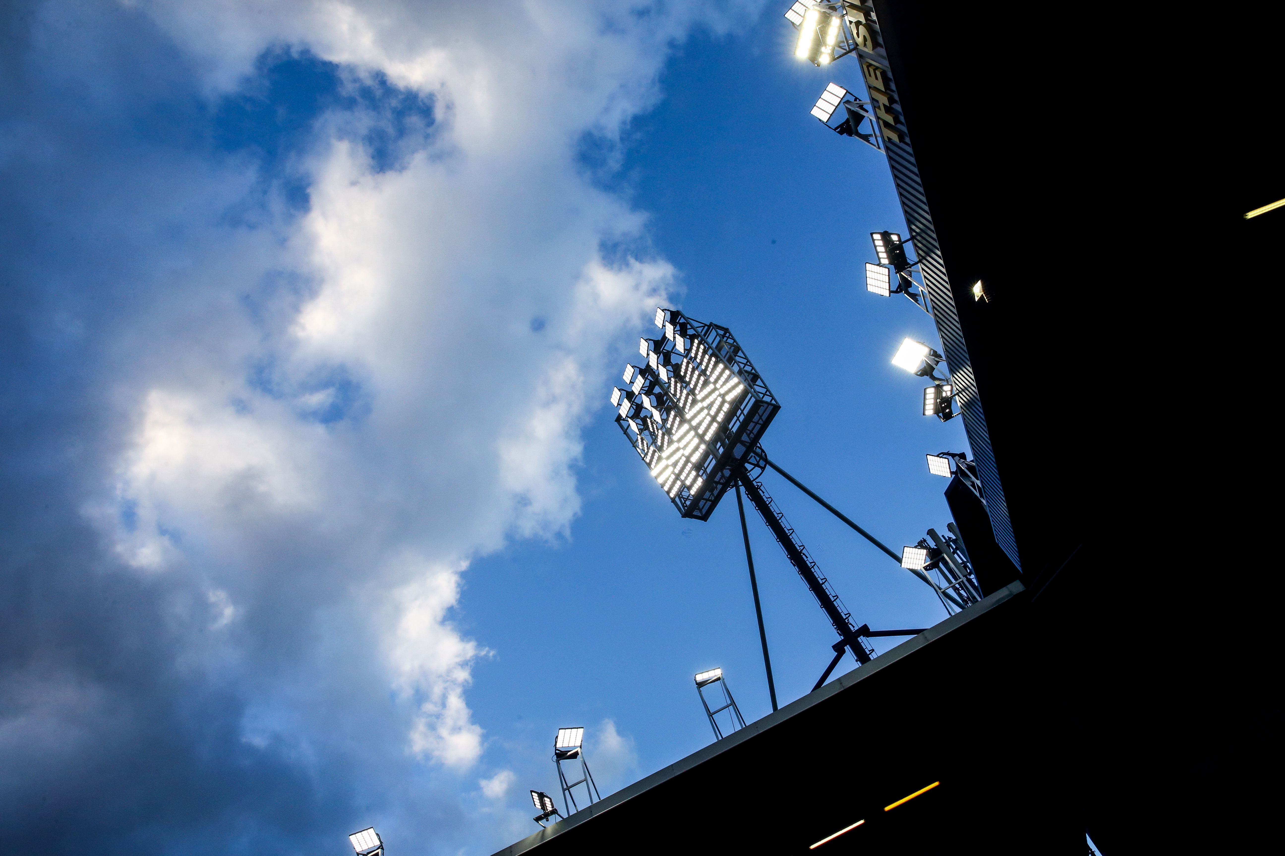

LOGOTYPE

Slide 52

VARATIONS & USAGE
MAIN LOGOTYPE
MONOCHROME WHITE
MONOCHROME BLACK
MAIN LOGOTYPE
Can be used everywhere
Exist in RGB and CMYK variants
MONOCHROME WHITE
To be used on red backgrounds
to protect our brand lisibility.
MONOCHROME BLACK
Only for single colour
printings on light backgrounds
MONOCHROME WHITE
Also for single colour
printings on dark backgrounds

Slide 53
SPONSORING
Red background border
is reduced to half its size

Slide 54
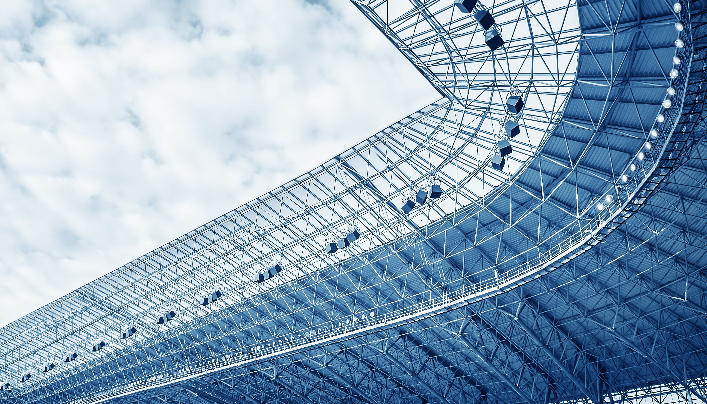
OTHERS

Slide 55
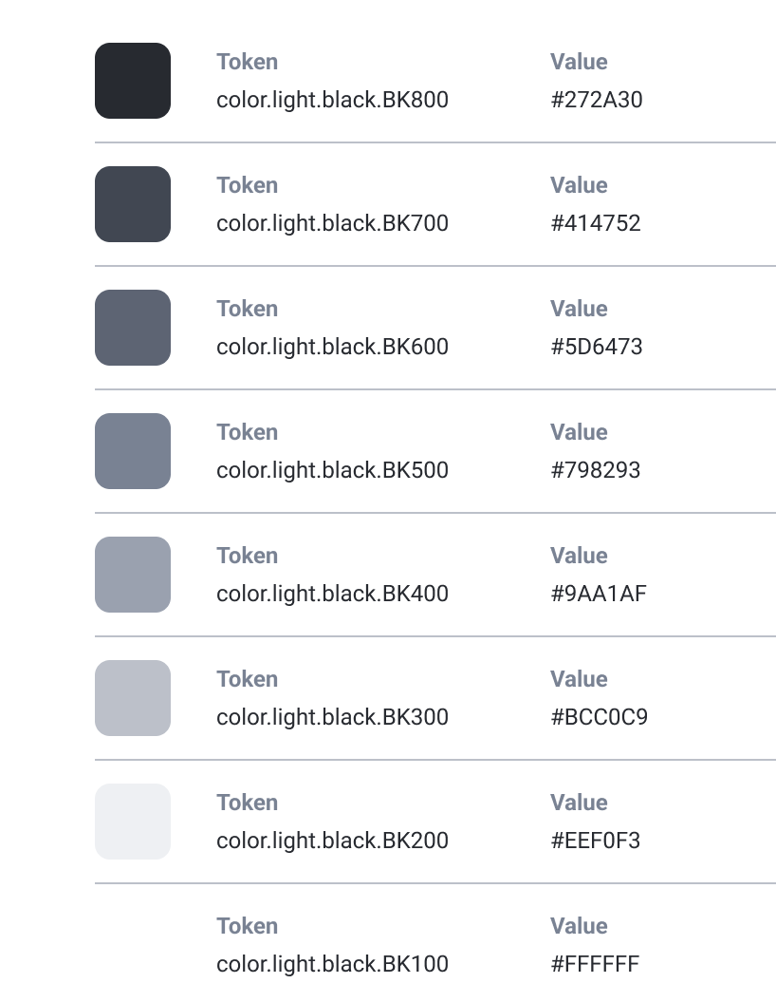
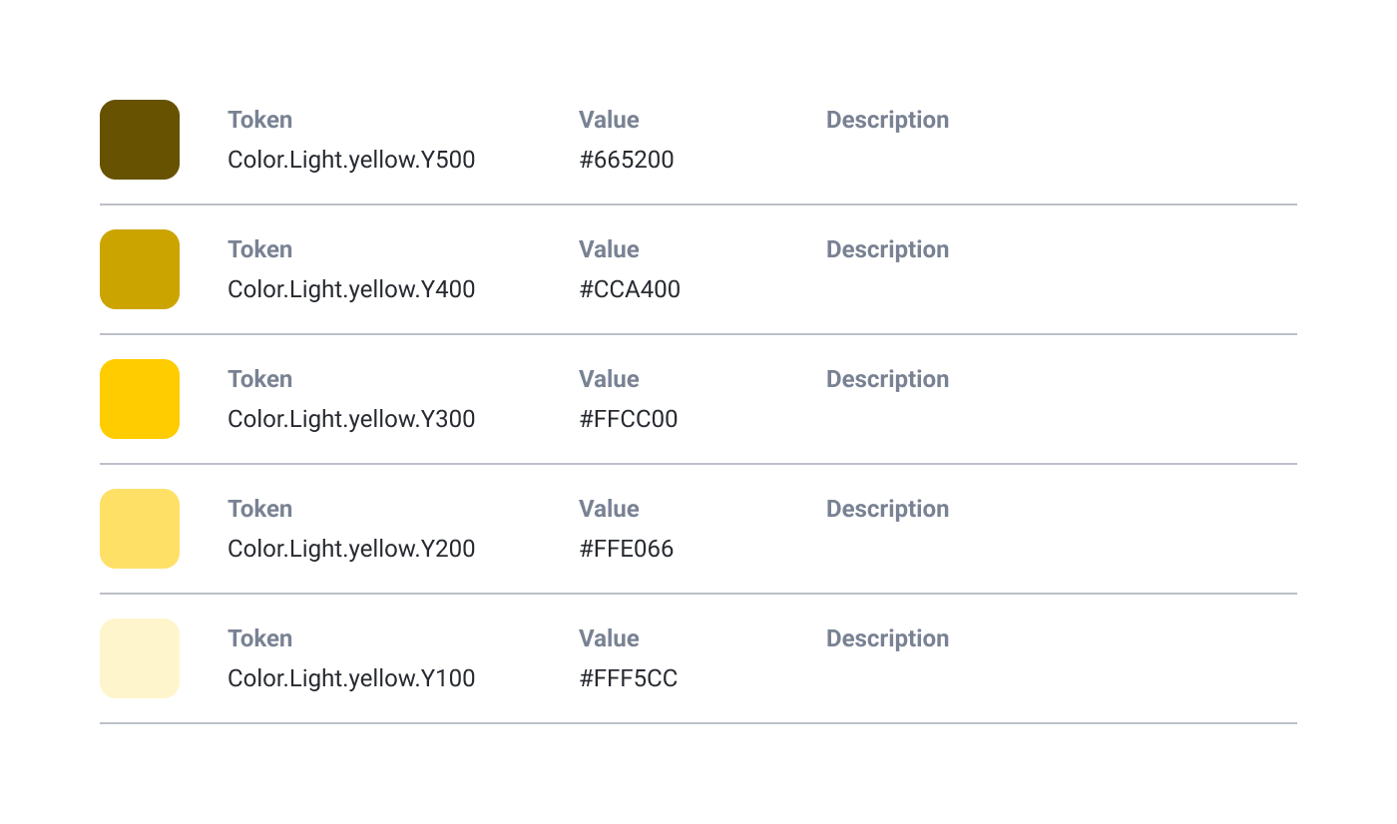
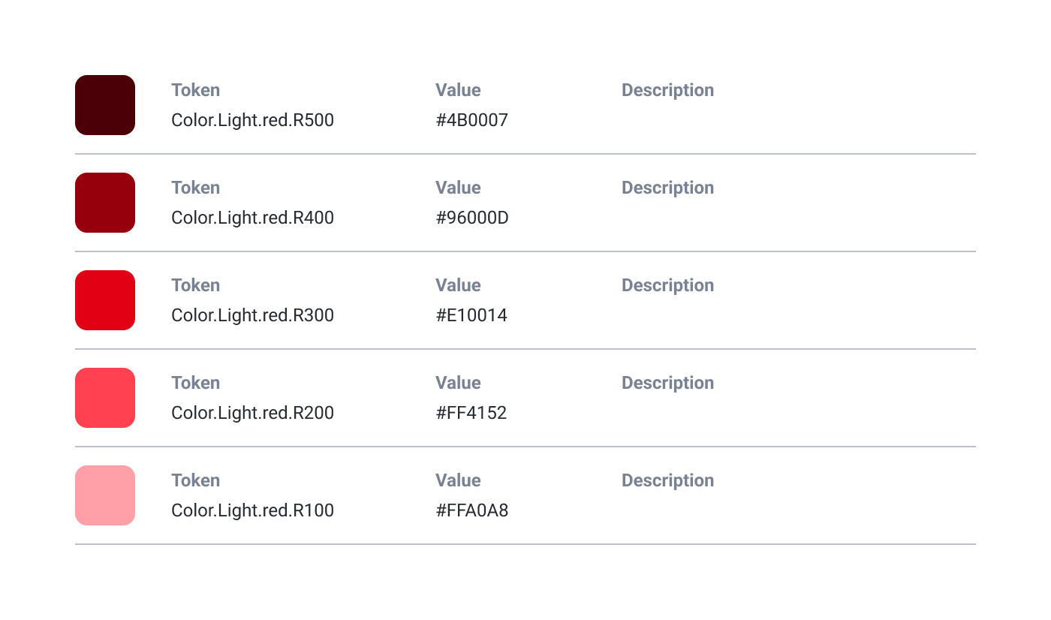
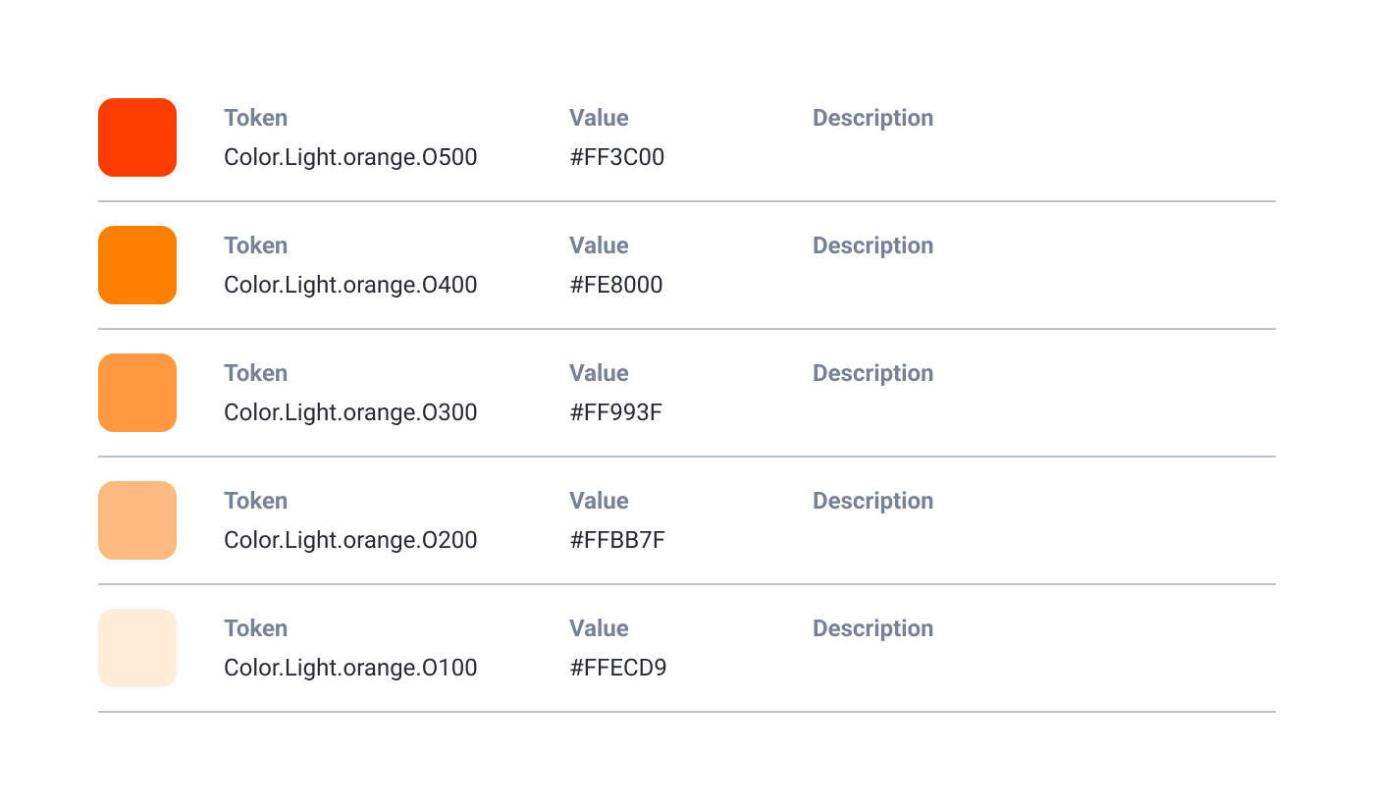
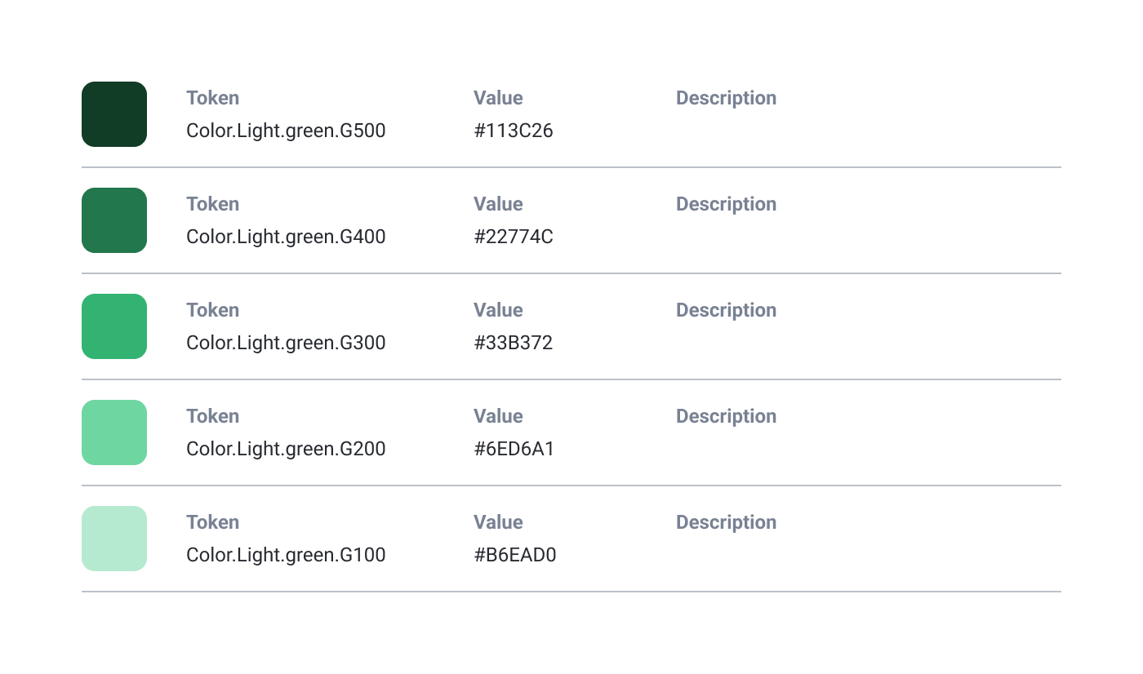
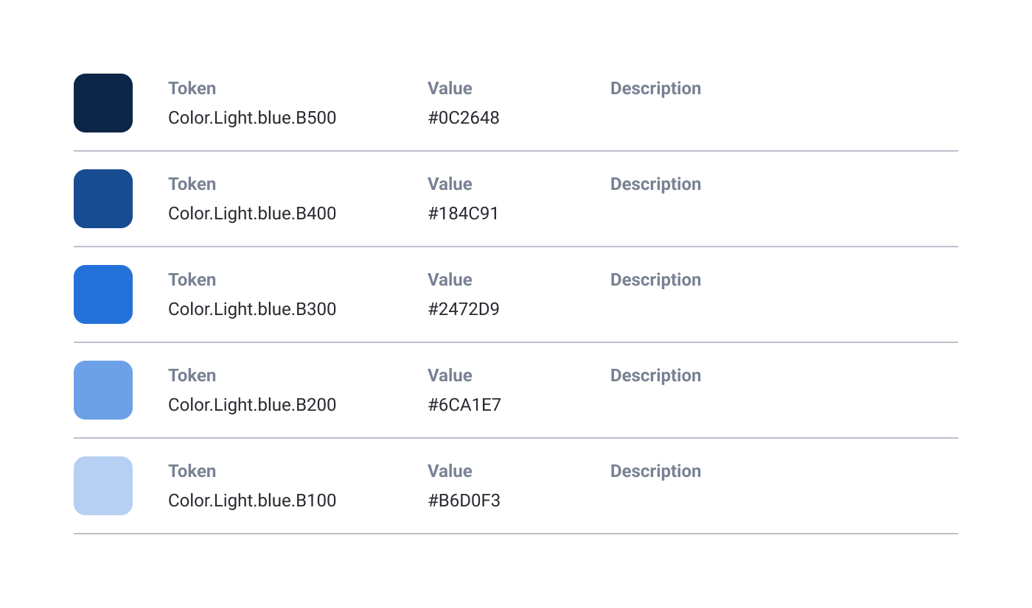
COLOURS

Slide 56
TYPOGRAPHIES
RIFT
ABCDEFABCDEF12345@&€!
Main title / eye-catching font. Cannot be used as a single font.
Weights: 5 - Styles: 2
METROPOLIS
ABCDEFabcdef1234@&€!
All purpose font.
Weights: 9 - Styles: 2

Slide 57
COLOURS
MAGMA
RGB:
#E10014
CMYK: 4-100-95-0
Pantone 2347C
RAL: 3000
Unique red for printings.
For logotype and
catchy elements in digital.
CLASSICO
RGB:
#D2161E
More stable red for bigger surface in digital
ODDZ
#FFCC00
#FFCC00
CMYK: 0-10-100-0
Pantone 116C
ALL WHITE
RGB: 1111111
#FFFFFFF
CMYK: 0-0-0-0
ALL BLACK
RGB: 1111111
#1111111
CMYK: 40-40-40-100

Slide 58
WRITTING COLOURS PRIORITIES
1 ALL WHITE
2 ALL BLACK
3 ODDZ
ALL BLACK
ONLy!
1 ALL WHITE
2 MAGMA
3 ODDZ
1 MAGMA
2 ALL BLACK

Slide 59
« FACTORY » BRAND PATTERN
To add creativity there is some variations around the Factory graphic concept.
FactoryF_P1
FactoryF_S1
FactoryF_S3
FACTORY LIGHT
FACTORY DARK
This graphic element can be used and modified to bring a visual branded touch.
FactoryF_P2
FactoryF_S2

Slide 60
OBLIQUES
90°
99°
81°
45°
If you need to rotate elements
to add dynamism,
pick one of these angles.
9°
0°

